Slide 1
AID: Autonomy in Disasters
Community Health Services Inc.
Sung Il Kang(Project Planner)
Ahmed Salem(Lead Engineer)
Abid Siam(Main Programmer)
Final Presentation
Date of Presentation: 12/06/2016
Section D1

Slide 2
Agenda
Project Objective
Background Information
Technical Design Information
Cost Estimate
Project Schedule
Summary

Slide 3
Company Profile
Founded in September 2016
Focused on building autonomous rescue robots
Company Goal: Eliminating unnecessary risks for emergency workers
Previous Clients: United States, Dominican Republic, United Nations, Taiwan, Italy, North Korea

Slide 4


Company Profile
 | Sung Il Kang Project Manager
Student at NYU Tandon School of Engineering B.S. for Computer Engineering
 | Ahmed Salem Lead Engineer
Student at NYU Tandon School of Engineering B.S. for Computer Science

Slide 5

Company Profile
 | Abid Siam Main Programmer
Student at NYU Tandon School of Engineering B.S. for Computer Engineering

Slide 6
Project Description
Background:
An Earthquake has damaged a nucear power plant
Led to emergency shutdown
President Billy Thai has ordered an RFP
Clean the area
Rescue the workers
Remove hazardous waste
Requirements:
Perform five out of six tasks
Return to home base in less than 5 minutes
Robot must fit in a start area less than 25cm x 25cm

Slide 7
Project Description
Design Considerations:
Occupy small surface area
Ability to strike cans
Small turn radius
Precise turns

Slide 8
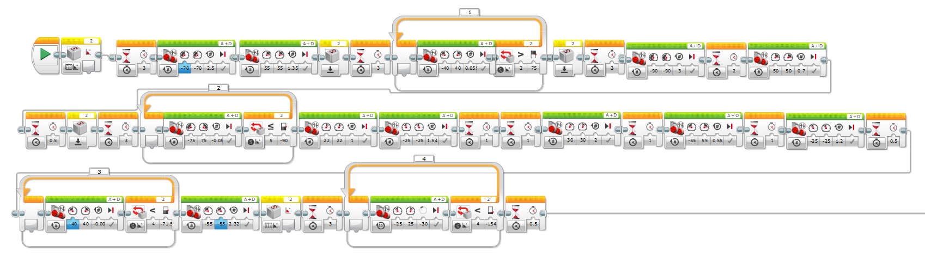
Project Description
Benchmark A:
Cuts power to facility
Goes up the hill

Slide 9
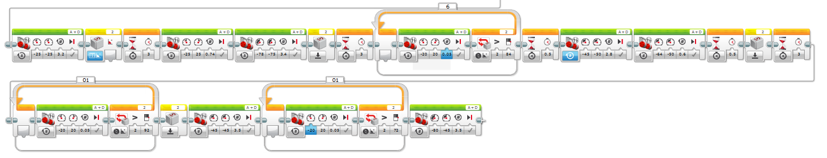
Project Description
Benchmark B:
Goes down the hill
Strikes Green can
Strikes Black can
Rescues Scientist

Slide 10
Project Description
Benchmark C:
Returns to base with Scientist
Code in progress

Slide 11
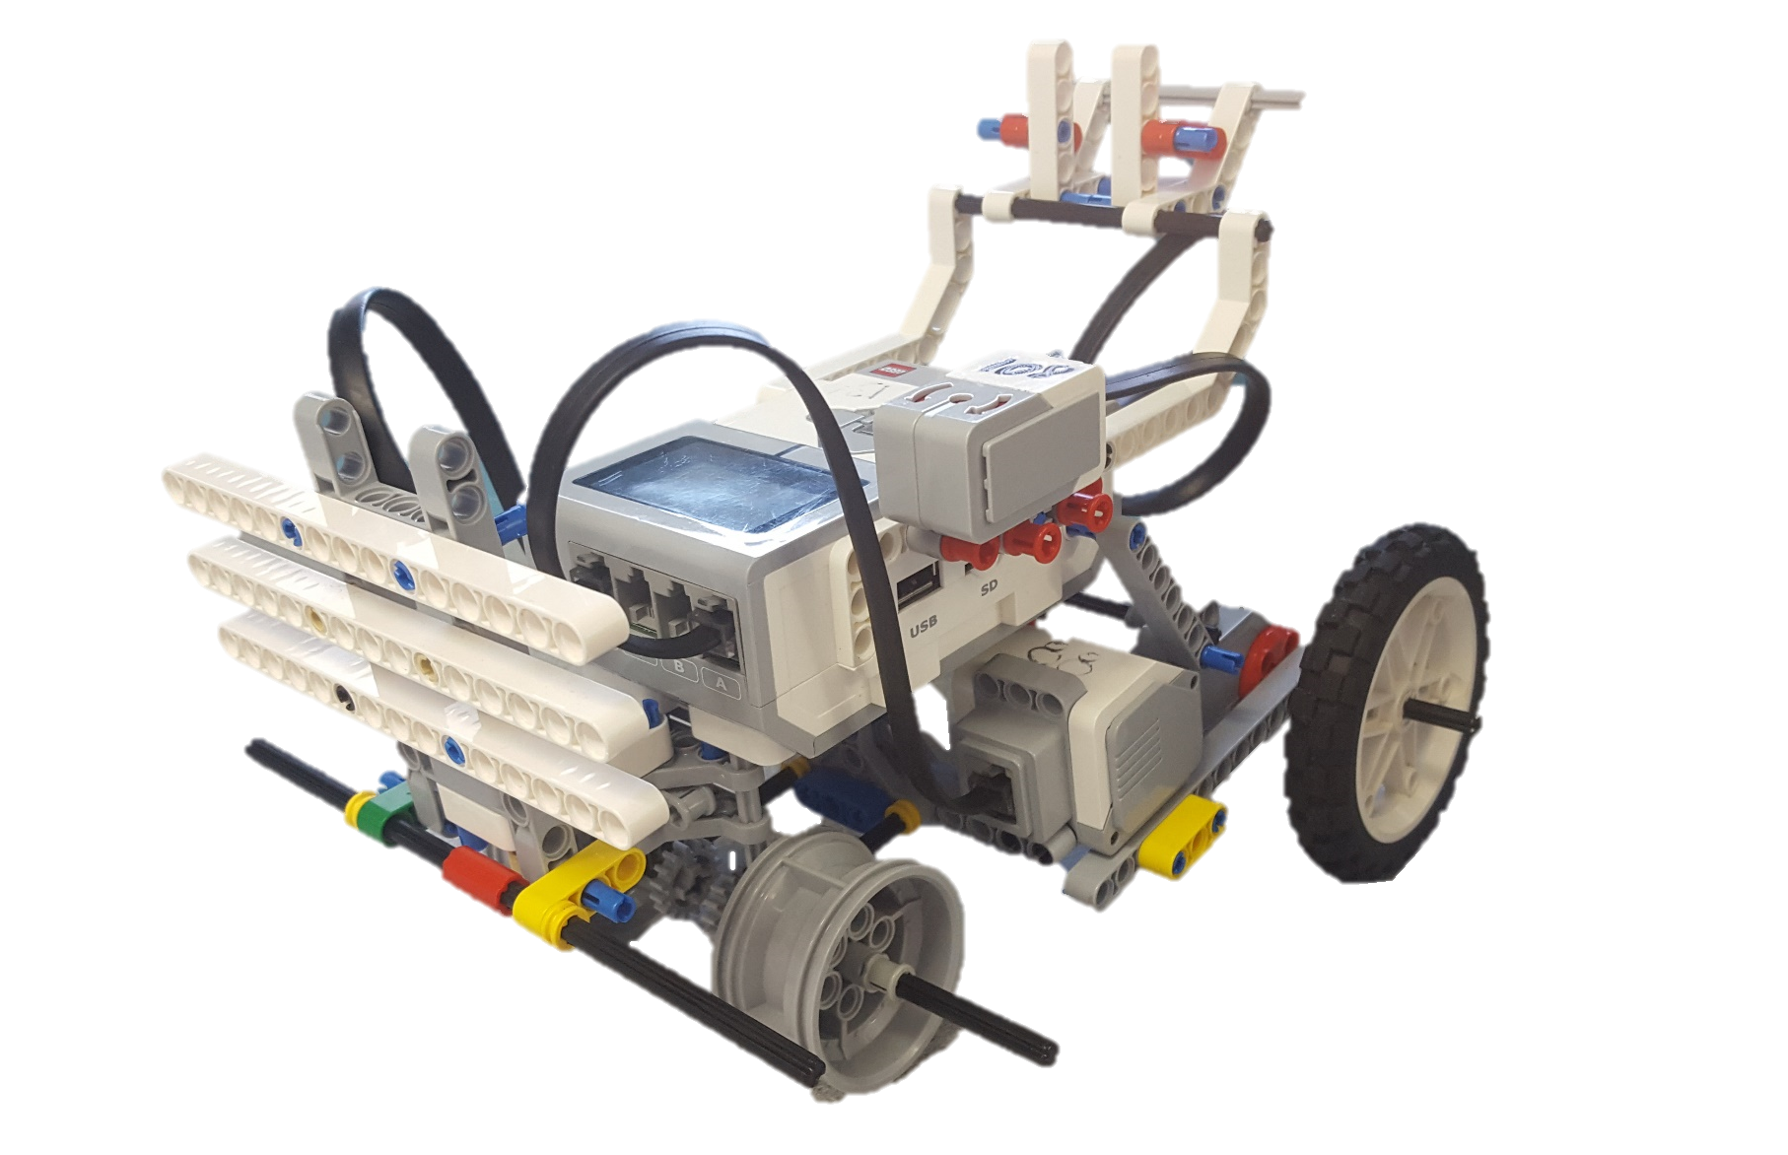
Technical Design Information
Gyro Sensor
Elevated Human Carrier
Can Striker
Primary Wheels
(Motors)
Extended Button Striker
Figure 1: Labeled robot description

Slide 12
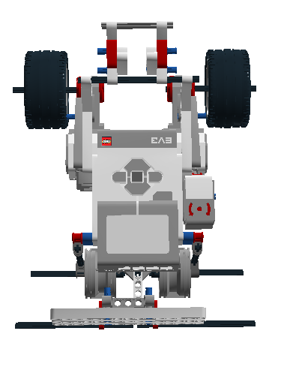
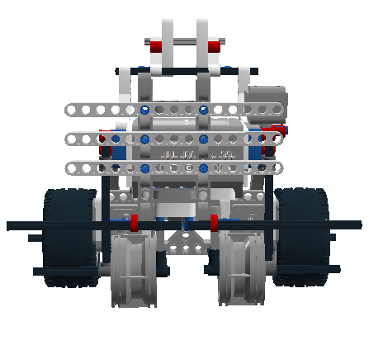
Technical Design Information
Top View
Front View

Slide 13
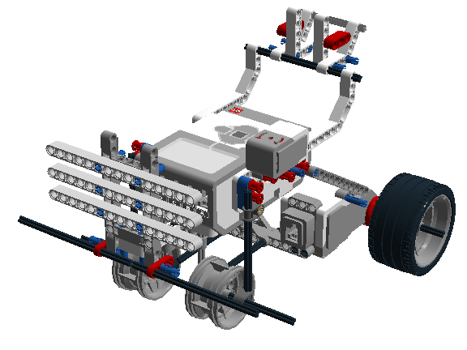
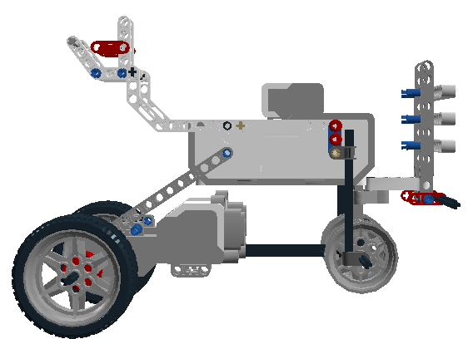
Technical Design Information
Isometric View
Side View

Slide 14
Cost Estimate
Table 1: Component expenses (No Change)
Name |  | Cost per Units | Total Units | Total Cost
Electric, Motor (EV3) |  | 218.2 | 2 | 436
Electric Gyro Sensor |  | 165 | 1 | 601
Miscellaneous |  | 103.3 | 1(47 parts) | 704
Labor |  | $50/hour | 3 | 5000
 | Project Planner | 30 | 1
 | Lead Engineer | 45 | 1
 | Main Programmer | 25 | 1
Total |  |  |  | $6741

Slide 15
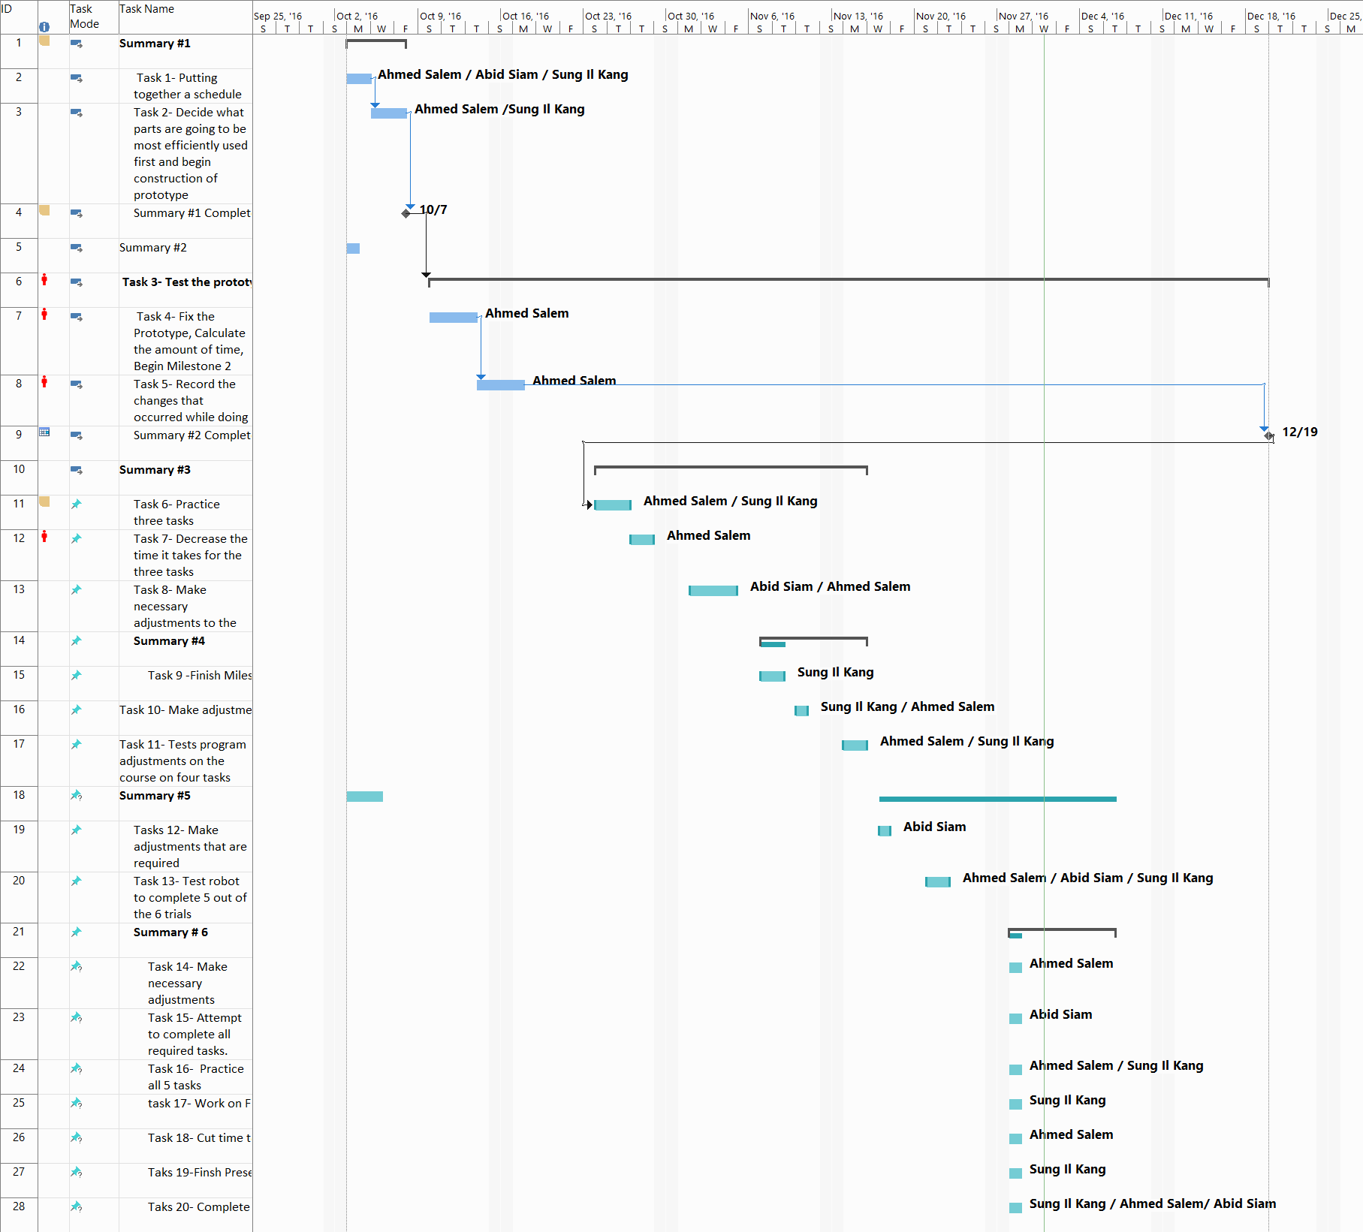
Project Schedule

Slide 16
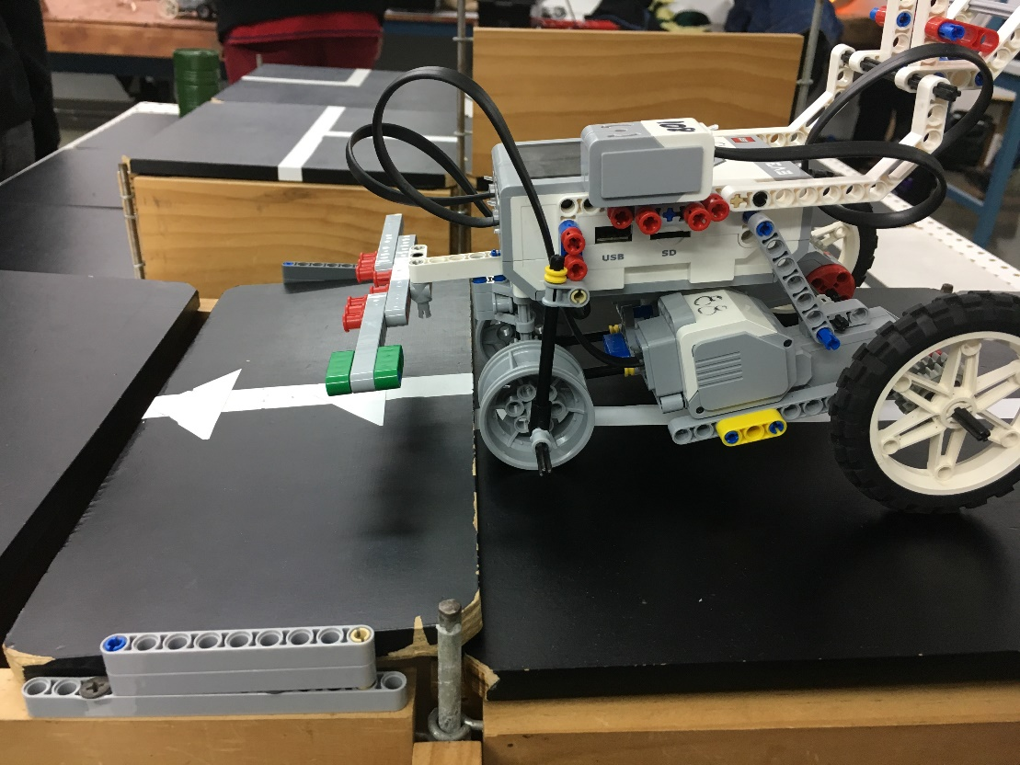
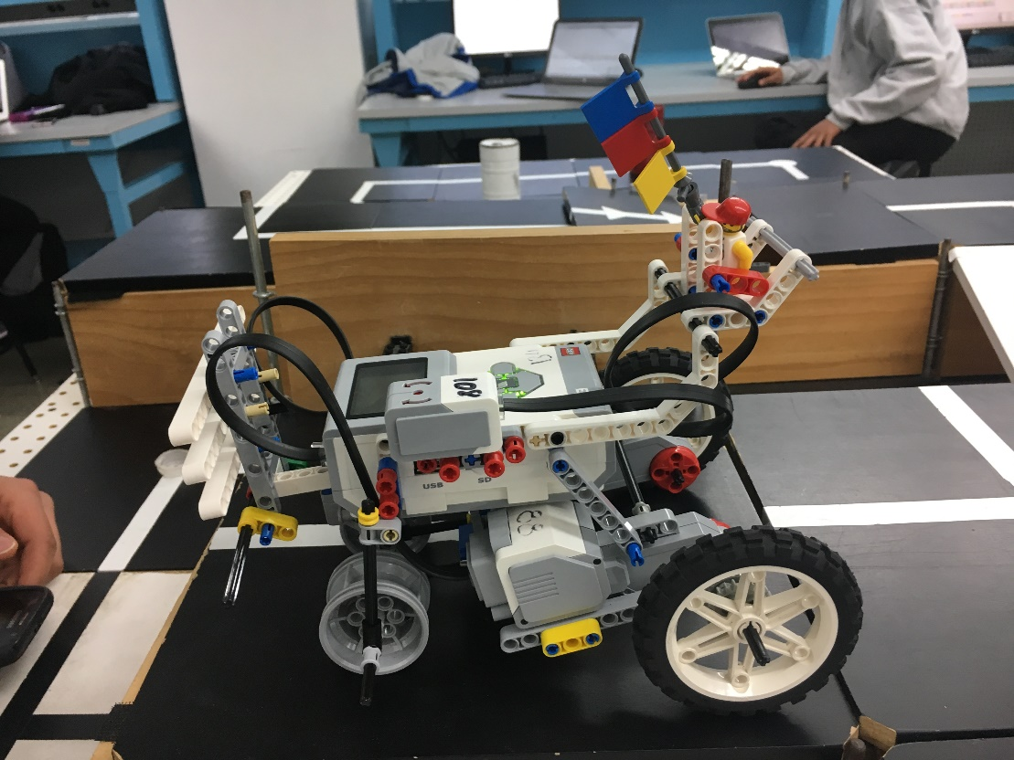
Advantages
Can Successfully do most of the course
AID moving the bridge into place AID rescuing the scientist

Slide 17
Advantages
Durable
Parts stay in place during impact
Safe and Stable
Only few moving parts
Precise
Gyro sensor ensures precision in turns
Accomplishes the tasks
5 of the 6 tasks completed

Slide 18
Conclusion
Why is AID the best choice?
AID is a robot built on stability, meaning any rescued scientist is safe without worry!
AID can survive a high amount of impact without worry of falling apart
AID does not contain many parts, meaning it is cheap to build, and cheap to purchase

Slide 19
AID: Autonomy in Disasters
Community Health Services Inc.
Sung Il Kang(Project Planner)
Ahmed Salem(Lead Engineer)
Abid Siam(Main Programmer)
Final Presentation
Date of Presentation: 12/06/2016
Section D1

